Slide 1
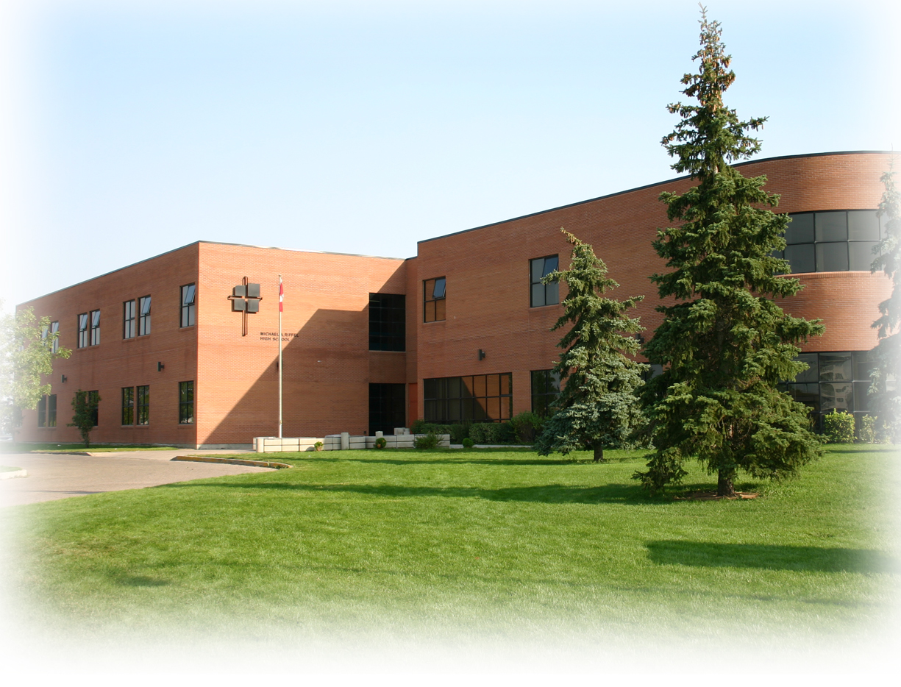
Welcome to Michael a. Riffel Catholic high school

Slide 2

Land acknowledgement
We wish to acknowledge that mistakes were made, and promises were broken to the Indigenous Peoples of Canada.
We value and appreciate living and learning on Treaty 4 Territory, traditional lands of the nêhiyawak, nahkawé, Nakota, and homeland of the Métis, Lakota, and Dakota nations.
We are committed to healing severed relationships through equity and justice, while embracing diversity. We are determined to restore and respect Mother Earth for future generations.
~Courtesy of Grade 8 Students of St. Nicholas School

Slide 3

O’Canada
Michael A. Riffel Catholic High School Vocal Jazz Group
with Ms. Stacy Allan

Slide 4

Prayer
Dear Lord,
A house is a building, whereas a home is a place where people are connected to one another, care for each other, learn and grow together. A home is a place where every person feels welcomed and loved. Lord, we know that everyone at Riffel is trying to make this place something more than a building, we are trying to make Riffel a home away from home. We ask that your welcoming spirit be evident as we meet with our future students and their parents this evening. May your loving presence be with us as we welcome all to our Riffel family and help prepare the foundation for a wonderful experience here, learning and growing in our faith, academics and relationships.
Amen
St. Gertrude the Great – Pray for Us
St. Gertrude the Great is our Patron Saint

Slide 5
Catholic School community council (C.S.C.C.)
CSCC Co-Chairperson
Mr. Olufemi Eseyin

Slide 6
Administrative greetings
Principal
Mr. Mark Wernikowski
Vice-Principal
Mr. Trevor Troy

Slide 7
Guidance counsellors
Ms. Kyla Warnecke
Ms. Lisa Hanson

Slide 8

Welcome, 2027 graduates!

Slide 9
Uphold the cross, Capture the crown
We are committed to working with our students as they continue to develop:
- Academically/Intellectually
- Emotionally/Socially
- Spiritually

Slide 10
Tools for success
1. Attendance – Regular and Punctual
2. Positive and Willing Attitude
3. Completion of Assignments
4. Preparation for class

Slide 11

How will you be supported?
Student Services – personal and/or post-secondary counselling, available during the school day by drop-in or appointment
Family Support Worker – personal counselling and/or family outreach support
Drug & Alcohol Counsellor – family and/or personal addictions support and awareness-building
Indigenous High School Advisor – relationship-building, connecting students to helpful resources for school success
Mental Health and Wellness Specialist – creates programming to build awareness on mental health topics and reduce stigma
EAL Program – supports culturally and linguistically diverse students in achieving grade level outcomes in the regular classroom.

Slide 12
How will you be supported?
Nutrition Program – healthy and delicious breakfast, snack, and lunch options at a reduced cost
Grade 9 Mentorship – relationship-building with Grade 9s to help incorporate strategies for school success
Learning Resource – ELA or Math pathway that allows for increased time and attention in learning concepts
Tutorial Periods – timetabled, teacher-supervised periods that replace an elective course if you are experiencing challenges in subject such as ELA or Math
Peer Tutoring – once-weekly noon hour subject-area help provided by student volunteers

Slide 13
Grade 9 courses
Grade 9 students will take 10 classes over the course of the year.
Catholic Studies
English Language Arts (one per semester)
Mathematics (one per semester)
Social Studies
Science
Arts Education
Health/Physical Education
One course of your choice (French or Practical and Applied Arts)

Slide 14
High performance programming
Riffel can accommodate high performance athletic training with the following programs:
Flexible scheduling by creating a hybrid schedule (face to face and Learning Online)
High Performance Phys Ed courses in grade 11 and 12 level.
High Performance Psychology/ Health Science / Life Transitions in grade 11 and 12

Slide 15
Regina catholic schools learning online
Learning online has provided course options to students in Regina Catholic School Division since 2009
More than 60 course options at all grade levels are available in Mathematics, Science, Social Studies, Humanities, Catholic Studies, Physical Education, Business Education and Technology
Learning Online is supported by Principal, Jodi Wilton
Courses are Asynchronous which means students can access course content where and when it fits into their schedule

Slide 16
Meeting students' academic needs
We offer specific programing to meet your needs in both ELA and/or Math
Regular programming
Learning Resource programming
Advanced programming
"How do I know what is right for my child?"
Discuss with your Grade 8 teacher!

Slide 17
Learning resource program
Riffel offers additional support to students who struggle academically.
Learning Resource (LR) Math and Learning Resource (LR) ELA courses at the grade 9 level.
Students achieve regular curricular outcomes in Learning Resources classes.
If you feel your child is a candidate, please discuss this with their grade 8 teacher.
More information to follow in break-out session in room 112

Slide 18
Advanced program
Riffel offers Advanced courses in ELA and Math
The Advanced pathway leads students through Grades 9 to 12 where they eventually challenge an international Advanced Placement exam where they can potentially earn a University credit.
Students should be highly motivated and open to a challenging and rigorous academic program.
If you feel your child is a candidate, please discuss this with their grade 8 teacher.
More information to follow in break-out session in room 116

Slide 19
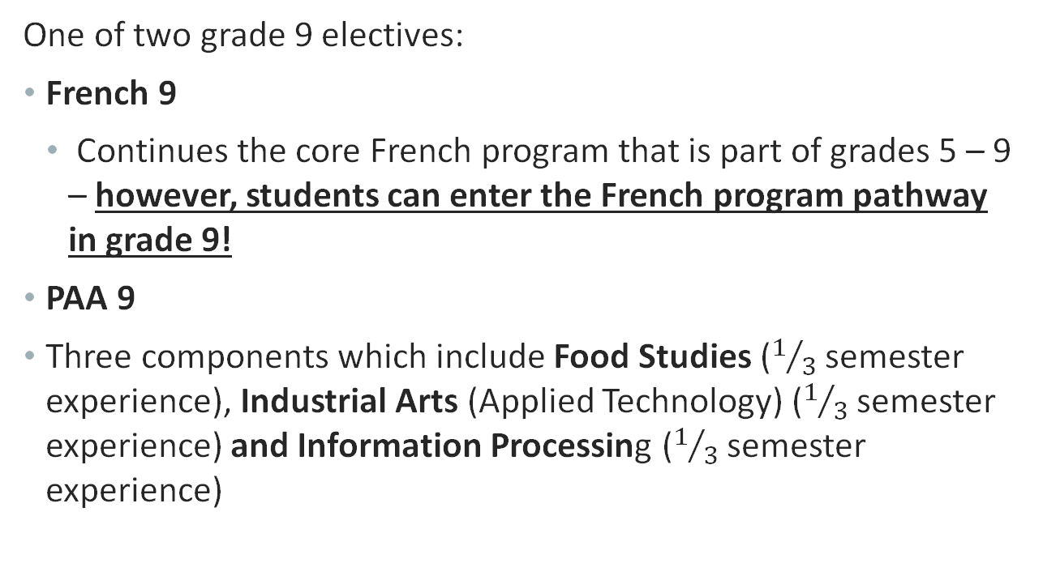
Elective class
One of two grade 9 electives:
French 9
Continues the core French program that is part of grades 5 – 9 – however, students can enter the French program pathway in grade 9!
PAA 9
Three components which include Food Studies ($1/3$ semester experience), Industrial Arts (Applied Technology) ($1/3$ semester experience) and Information Processing ($1/3$ semester experience)

Slide 20
Sample schedule
Semester 1 | Semester 2
ELA A9 | Social Studies 9
Arts Education 9 | ELA B9
Science 9 | French 9 (or PAA 9)
Physical Education 9 | Math B9
Math A9 | Catholic Studies 9

Slide 21
Passion for Music
Classes are Early Bird (7:45 am to 8:45 am) or at lunch.
Open to all students.
Choral 9
2 times per week and sectionals
Vocal Jazz 9
2 times per week (must audition and must be part of Choral)
Band 9
2 times per week and sectionals

Slide 22

Extra-curricular programs
Clubs
Art Club
Best Buddies
Book Club
Canteen
Chamber Choir/Ensemble
Drum Group
GSA
Honour Choir
Drama and Improv
St. Faustina Swim
Mega Volley/RIT
Peer Tutoring
Praise and Worship Music
Scorekeepers
SRC
Team Manager/Athletic Trainer
Yearbook
Sports
Badminton
Basketball
Cross Country
Curling
Football
Flag Football
Golf
Hockey
Soccer
Track and Field
Volleyball
Wrestling
Get involved!!

Slide 23




Follow us on social media / Internet
Michael A. Riffel Catholic High School
@riffelroyals
@RiffelRoyals
https://www.rcsd.ca/school/MichaelARiffel

Slide 24
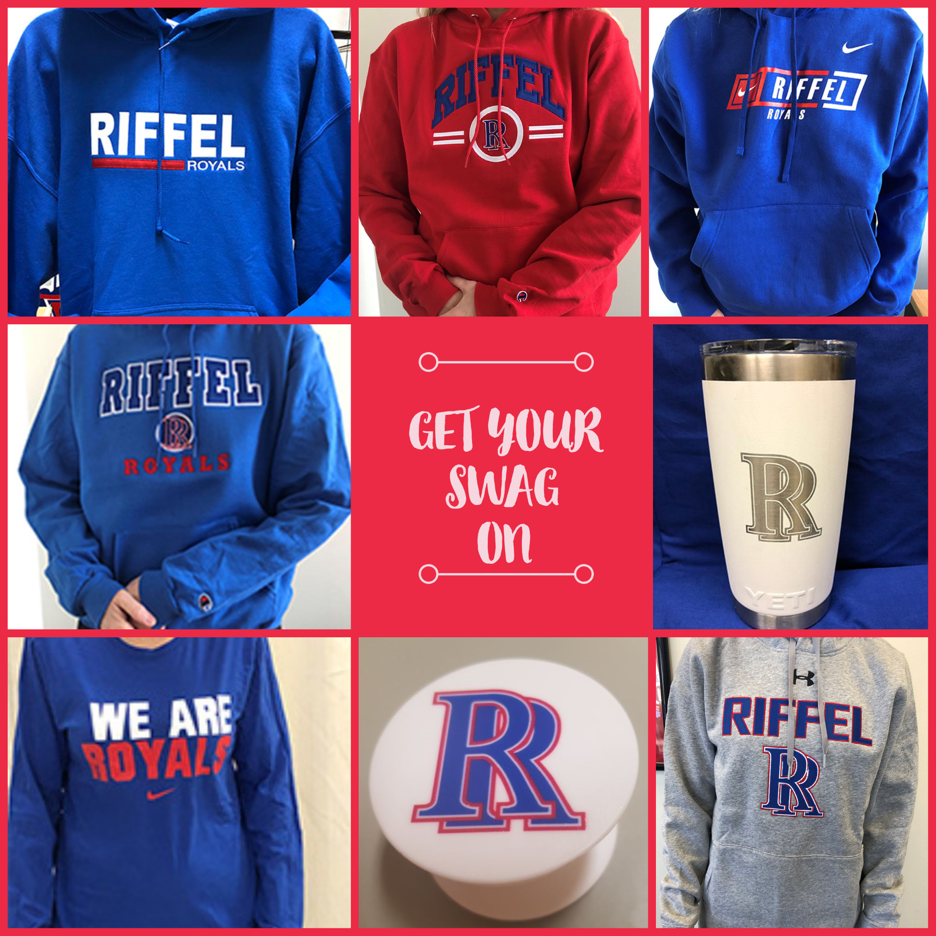
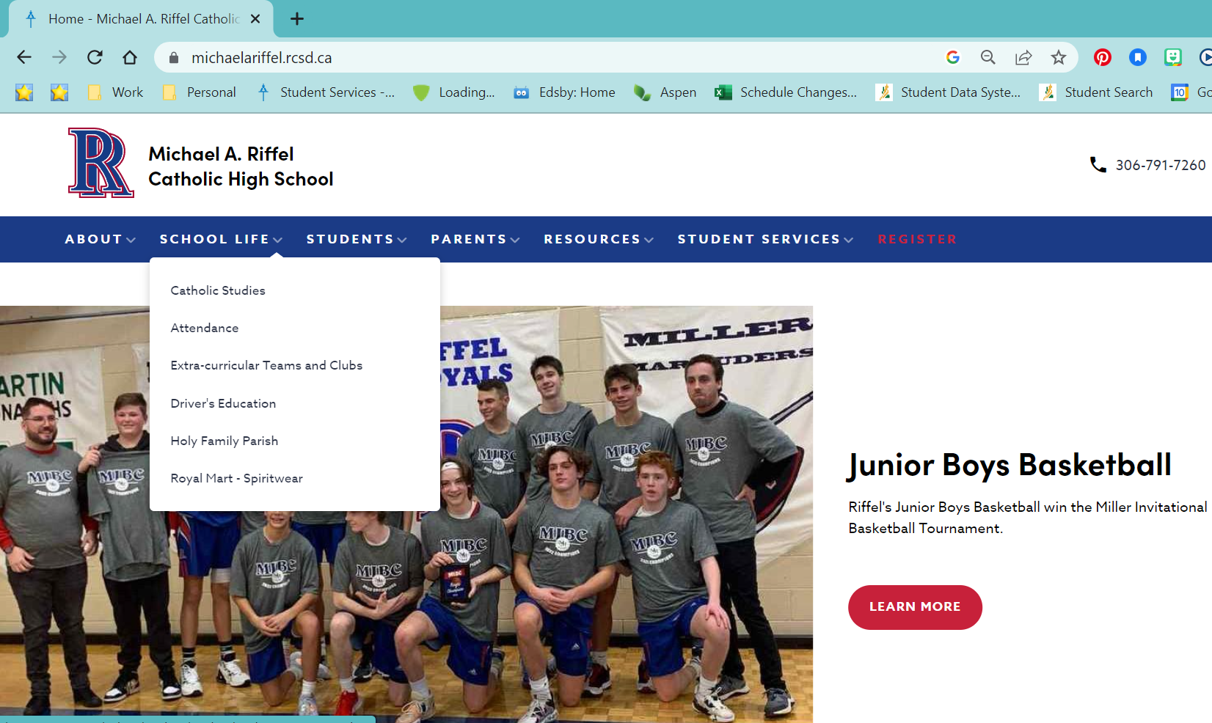
Riffel royal mart

Slide 25
Registration forms
Please return your registration form to your grade 8 teacher due on or before:
Friday, February 17, 2023
Associate schools – leave your registration form with your grade 8 teacher or drop it off at the Riffel Main Office
Non-associate schools (RCSD or RPS) - please complete online registration found on the Riffel home page.

Slide 26
Questions?
Learning resource Presentation Rm. 112
Advanced placement presentation rm 116
School tour
Contact student Services at RiffelGuidance@rcsd.ca

Slide 27
Extra-curricular programs
Clubs
Art Club
Best Buddies
Book Club
Canteen
Chamber Choir/Ensemble
Drum Group
GSA
Honour Choir
Drama and Improv
St. Faustina Swim
Mega Volley/RIT
Peer Tutoring
Praise and Worship Music
Scorekeepers
SRC
Team Manager/Athletic Trainer
Yearbook
Sports
Badminton
Basketball
Cross Country
Curling
Football
Flag Football
Golf
Hockey
Soccer
Track and Field
Volleyball
Wrestling
Get involved!!

