Slide 1

Michael A. Riffel Catholic High School parent Graduation Meeting
Welcome, Grade 12 students and families!

Slide 2
Land acknowledgement
In the name of the Father, the Son, and the Holy Spirit. Amen. Loving Creator, please watch over our students and their families as they prepare for graduation.
Bless our students with Your gifts of wisdom and knowledge and the courage to aspire to greatness, as is Your intention for all of us.
In Jesus’s name we pray.
In the name of the Father, the Son, and the Holy Spirit. Amen.
prayer
We are blessed to guide and support students on their journey toward graduation on Treaty 4 territory, traditional lands of the nêhiyawak /ᓀᐦᐃᔭᐊᐧᐠ, nakawē / ᓇᐦᑲᐌ /, and Nakota nations, and homeland of the Métis, Lakota, and Dakota nations.

Slide 3

INTRODUCTIONS​
Mr. Wade Hackl, Principal of Michael A. Riffel Catholic High School​
Mrs. Lisa Hanson, Guidance Counsellor & Graduation Chair​
Ms. Karla Ruggieri, Out-going Prom 2021Chair​
Thank you to out-going Grad Chair, Ms. Jolene Orthner!
Welcome to students and their families!​

Slide 4
Graduation eligibility
Participation in the graduation mass and exercises is dependent upon:
24 credit units, including Catholic Studies 30
The compulsory requirements outlined by the Ministry of Education
A determination of a student’s eligibility will be made after June 3, 2022 and will be dependent upon a student having a passing grade in all required courses

Slide 5

Board-sanctioned: Mass & exercises Non-board-sanctioned: prom (parent run)
Michael A. Riffel Catholic High School is pleased to be formally involved with the Graduation Mass and Exercises. These two events are school Board sanctioned activities that all Regina Catholic High Schools are required to organize, plan and supervise on behalf of graduating students and families. As such, it is very important that all students and families observe the regulations concerning appropriate dress, drugs/alcohol and respectful behavior as outlined in RCS School Board policies and our School Student Handbook.
For Grad 21/22, each Graduand will be allotted 8 tickets (1 for the Graduand, and 7 guest tickets) for Mass & Exercises.
A Grade 12 Prom has traditionally been organized by a parent committee near the end of May. In regards to this event and any other events/activities organized around and outside of the graduation mass and exercises, please keep in mind that they are not School Board sanctioned graduation events and therefore are not a part of Regina Catholic Schools’ supervision and liability.
2021 Prom Chair – Introduction & Transition to 2022 Prom Chair

Slide 6
September to may timeline
September – February:
Payment of Grad fees (deadline February 1, 2022)
February:
Register online for Grad photos (link in booklet)
March:
Cap and Gown Pictures - March 14-18, 2022 (Riffel Commons Area from 9:00 am to 3:00 pm)
You must have your picture taken for the yearbook and composite even if you are not purchasing a package.
Retake Date – At the studio. Call (306) 949-8448 for a retake appointment.
Please review Grad Booklet for additional details.
May:
Voting on Grad Speeches

Slide 7
June timeline
June:
Friday, June 3, 2022 – Grad eligibility determined.
Monday, June 20, 2022 – Period 3 – Grad Rehearsal Attendance is mandatory. This rehearsal is absolutely essential and its importance cannot be overemphasized.
Monday, June 27, 2022 – Graduation Gown, Cap and V-stole pick-up between 11:00 am – 12:30 pm in the Riffel Commons Area.
Wednesday, June 29, 2022:
Graduation Mass and Exercises – We are planning for a traditional mass and exercises that will take place on Wednesday, June 29, 2022 at 1:00 pm. This will take place at Resurrection Parish. Should gathering limits be in place and we cannot gather as a full school community, we have a number of other plans that we are finalizing to celebrate our graduates. Please check the Graduation page on our school website regularly to stay up to date.

Slide 8
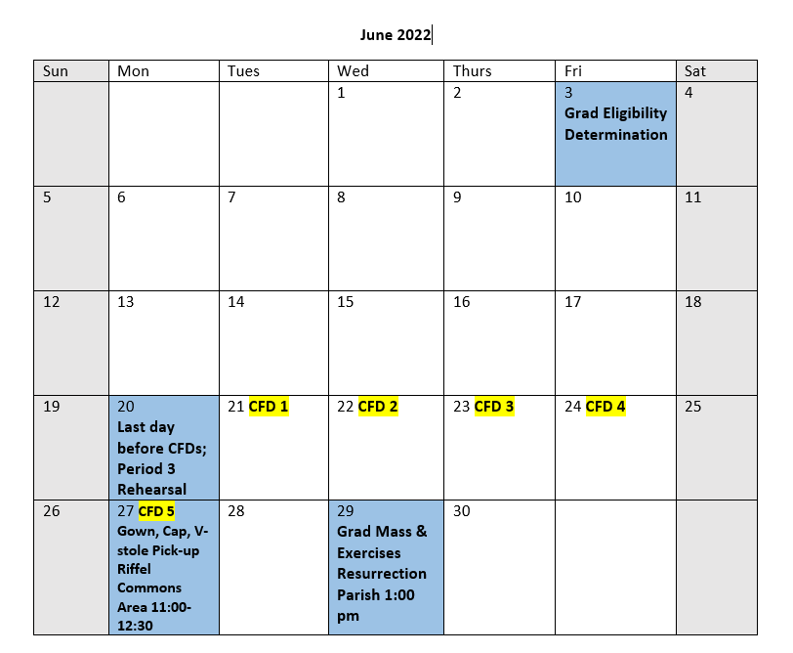

June calendar

Slide 9
Graduation fees
Graduation fee of $100.00 includes:
Cap, v-stole and gown rental, church and hall rental, printing of programs, printing of invitations, printing of certificates, mass and exercise tickets, art legacy and miscellaneous liturgical and guest-related items.
Graduation Fee deadline is Tuesday, February 1, 2022.
All grad fees are to be paid via SchoolCash online program. The link is located at the bottom of the school website.

Slide 10
Graduation day
Graduands will proceed into the church at the start of mass and will sit together in a designated area (Graduands will rehearse this process at the mandatory graduation rehearsal on Monday, June 20, 2022 during period 3). Graduands will carry the graduation cap under their arm as they process into the church.
Graduation exercises will immediately follow the graduation mass. During the Salutatorian Address, Graduands will be asked to put on the graduation cap.
All Graduands will meet at St. Gabriel Elementary School (across the street from the church) at 12:15 p.m. and a group picture will be done at this time by our official photographer (the picture will be made available to all families).
Doors to Resurrection Parish will open at 12:30 pm and the graduation mass and exercises will begin at 1:00 pm. Admission to the graduation mass and exercises is by ticket only including children. Seats are available on a first-come basis. Certain rows at the front of the church will be reserved for the Graduands.
Please remember that Resurrection Parish, similar to facilities like the Conexus Arts Centre, does not allow food or drink in the church and/or the auditorium during graduation mass and exercises.
Resurrection Parish also does not allow hats to be worn inside the church and/or auditorium (an exception is made only for the graduation caps worn by our Graduands.
Resurrection Parish must enforce the provincial and city smoking bylaws which state that smoking/vaping is not allowed inside a public building at any time, and that such activities must be done outdoors a minimum of three metres (15 feet) from any building entrance.
For the benefit and enjoyment of all those in attendance for our graduation mass and exercises, we are requesting that individuals refrain from leaving the building during any portion of the mass or the graduation exercises. This ensures that noise and distractions are at a minimum. The entire program runs approximately 2 ½ hours and this may prove lengthy for small children.
Wednesday, June 29, 2022
1:00 pm
Resurrection Parish

Slide 11
ACADEMIC DRESS REQUIREMENTS (CAP & GOWN)
The academic dress worn by the Graduand consists of a blue gown, cap and a red v-stole. The cost is included in the graduation fee.
Gowns, caps and v-stoles MUST be picked up at the school on Monday, June 27, 2022 in the Commons Area between 11:00 am and 12:30 pm.
Dress clothing is required under the gowns. Boys may wear a shirt and tie, dress pants and dress shoes. Girls may wear either a dress, or a top and dress pants and dress shoes. NO shorts, flip-flops, or beach type shoes of any kind may be worn.

Slide 12

VALEDICTORIAN & SALUTATORIAN
VALEDICTORIAN:
Serves as the representative voice of the entire graduating class. This position should be looked upon as an honour.
SALUTATORIAN:
Also an honoured position, has the responsibility of welcoming everyone to the graduation.
Procedure for Selecting the Valedictorian and Salutatorian:
The top four eligible graduands based upon Semester One averages are eligible and have been nominated for Valedictorian and Salutatorian. The nominee receiving the highest number of votes will be the Valedictorian and the nominee receiving the second highest number of votes will be the Salutatorian. These speeches will be determined based on grad eligibility.
The Valedictorian and Salutatorian must have their speeches approved by the Graduation Chair and School Administration. School Administration reserves the right to remove any student from these roles if they do not adhere to the recommendations regarding speeches.

Slide 13
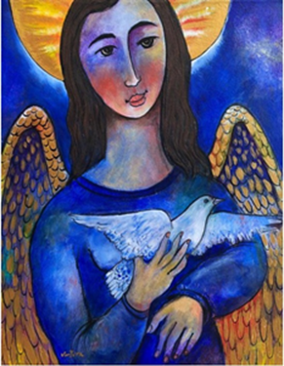
Art Legacy
Graduating students contribute towards the purchase of a piece of art, which is donated to the school as their legacy.
The works of art from previous years are displayed at the school with accompanying plaques indicating title, artist, year and contributor.

Slide 14

Thank you for attending!
Any questions? Please ask! Or…
Email Wade Hackl, Principal – w.hackl@rcsd.ca
Email Lisa Hanson, Graduation Chair – l.hanson@rcsd.ca
Riffel Main Office – 306-791-7260

