Slide 1


Michael A. Riffel Catholic high school Scholarship information

Slide 2
We wish to acknowledge that we are blessed to live and work alongside tremendous educators and wonderful students on Treaty 4 territory, traditional lands of the nêhiyawak, nahkawé, and nakota nations, and homeland of the métis, lakota, and dakota nations.
Prayer & Land Acknowledgement
+ Dear God, Please watch over our students and their families as they make decisions about their futures. Help us always to understand that you are present in the details and the outcomes, no matter what path is ultimately chosen. Amen +

Slide 3
Riffel graduates of 2021 were offered approximately $140,000 in scholarship money

Slide 4
Here are some interesting facts you may not know
- There is an award for you - there is over $50 million in entrance scholarships available​ ​ - You don’t need to have high marks - most awards do not require an academic average at all​ ​ - Keep searching throughout the year - awards have deadlines throughout the year ​ ​ - You can’t win an award if you don’t try - many awards have few applications ​ ​ - Get involved in your community – many awards require some school or community service​ ​ - Look beyond colleges and universities for awards - there are over 1,000 award providers; the majority of which are companies, associations and other non-educational organizations​
Notes:
Interests!

Slide 5
Scholarship terms
Award - An award is given in recognition of outstanding achievement. Awards may be in the form of books, plaques, subscriptions or money. A monetary award is usually called a scholarship or bursary. Bursary - A non-repayable grant of money. Bursaries are awarded primarily based on financial need, but academic achievement is also considered. Usually, the applicant must provide detailed documentation describing their financial situation when applying for a bursary.
Scholarship - A non-repayable sum of money awarded to a student to help finance further education. Most scholarships are based on merit in areas ranging from academic achievement to athletics. Usually, scholarships are not based on financial need.
Entrance Award/Scholarship - A scholarship or award given to a student entering his/her first year at a post-secondary institution. Also referred to as an Admission Award.
Notes:
Interests!

Slide 6
types of scholarships
1. Academic
2. Leadership
3. Community Involvement
4. Sports
5. Essay
6. Special Groups
7. Financial Need
8. Blended
Notes:
Interests!

Slide 7
How do students find and win scholarships, awards, and bursaries?

Slide 8
Step 1:
Compile an activity-based resume
Use only the last 3-4 years
Organize all applicable experiences, recognitions, etc., into activity areas:
Leadership
Community
Extra-curricular clubs/sports
Accomplishments/awards
Volunteer
Employment
Goals/future plans
education

Slide 9
Use myblueprint or other resume builder
myBlueprint.ca is an amazing tool for career and post-secondary research.
There are a number of learning style and personality quizzes that can point you in a career direction.
It also contains THE BEST resume builder – super easy, and it looks great too!
Log in and check out myBlueprint.ca!
Notes:
Interests!

Slide 10
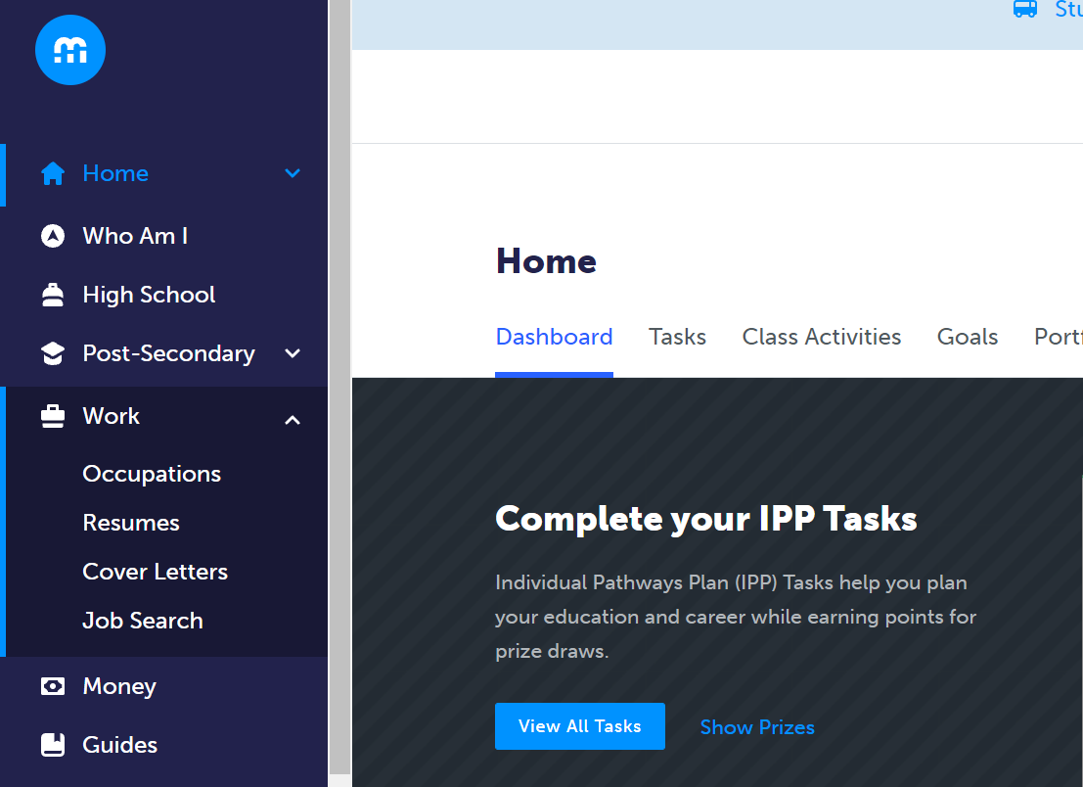
On myblueprint, find the resume tab, and build away!

Slide 11
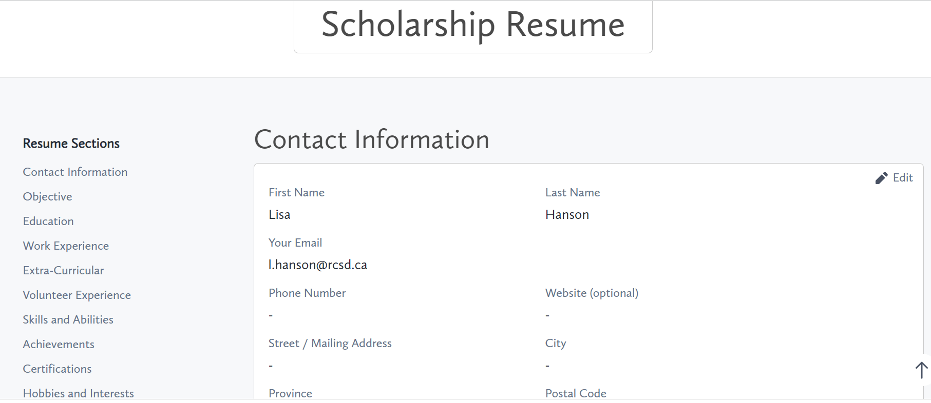
The tool is simple to use, and you build and save, category by category.

Slide 12
Step 2:
begin your search
1. Parents and Grandparents:
ask about employer, union, professional organization, service club, parish council, & community association​ involvement and scholarship opportunities.
2. Students:
Ask your employer, listen to announcements, search scholarship websites
3. Riffel Student Services site:
Student services scholarships
4. Riffel Grad Awards site:
for students graduation news grad awards
5. post-secondary institutions:
Check their sites/databases and note deadlines!

Slide 13
A note about post-secondary institution scholarships
- SaskPolytechnic, the University of Regina, and the University of Saskatchewan (as well as all other institutions) have scholarship options – please visit their websites and look around in the scholarship areas!
- All applications for post-secondary institution awards are online.
- Some institutions have automatic entrance awards based on your early conditional average!
- Please check when your application must be completed in order to be considered for entrance scholarships.
* For example, the U of S requires your application to be in by December 1st in order to be considered for their 'Best & Brightest' awards.
Notes:
Interests!

Slide 14
Step 3:
Contact 3 references 2 weeks prior to the first scholarship deadline
- Always ask people with whom you have developed a good rapport (at least 2 teachers and 1 member of the community)
- School letters of reference should discuss academic qualifications, extra-curricular activities, and personal qualities. Community letters should emphasize contributions made to the organization and personal qualities
- give your references a copy of your resume so they may discuss your activities in the letter
- Give your references the scholarship criteria
- Ask them to save the letter so that you can request future letters specific to new scholarship criteria
- Always provide at least two weeks' notice
- remember to thank your references!

Slide 15
Be organized!
Keep a binder or electronic folder of scholarship information including:
Copies of completed applications
Reference letters
Electronic files resumes, paragraphs, essays
Be neat!
Your completed application reflects your skills and abilities
Read and follow directions
Beat deadlines by at least 3 days!

Slide 16
Thank you for attending any questions? please ask! or visit student services or email us at riffelguidance@rcsd.ca

