Slide 1

course selection parent information night
Michael A. Riffel Catholic High School

Slide 2
Land acknowledgement
We wish to acknowledge that we are blessed to live and work alongside tremendous educators and wonderful students on Treaty 4 Territory, traditional lands of the nêhiyawak, nahkawé, nakota, and homeland of the métis, lakota, and dakota nations.

Slide 3

Prayer
Hail Mary,
Full of Grace,
The Lord is with thee.
Blessed art thou among women,
and blessed is the fruit
of thy womb, Jesus.
Holy Mary,
Mother of God,
pray for us sinners now,
and at the hour of our death.
Amen.
Please join us!

Slide 4
Administrative Greetings
Principal – Mr. Mark Wernikowski

Slide 5
What should I consider in selecting courses?
Graduation Eligibility
  Personal Graduation Checklist found in Student Services and on the Student Services page of the Riffel website
Interests and Skills
  What do you like to do? What do you enjoy learning about?
Possible Career Goals
  Each career path/post-secondary program will offer a unique set of academic requirements. Begin researching programs of interest.
  www.myblueprint.ca (see Guidance Counsellor for username/password if needed)

Slide 6
Graduation eligibility
In order to participate in the graduation mass and exercises, a student attending a Regina Catholic High School must have the potential to earn 24 credits including Catholic Studies 30 and the compulsory requirements as outlined by the Ministry of Education by June 30 of that academic school year.

Slide 7
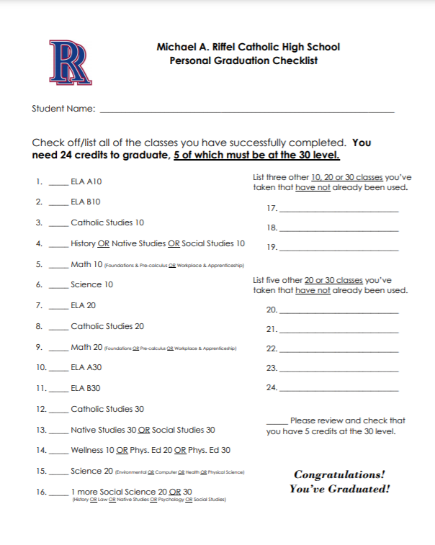
Personal Graduation checklist
Riffel Student Services Web Page

Slide 8
What should my course selections include for grade 10?
1. ELA A10
2. ELA B10
3. 10-level math (Workplace/Apprenticeship Math 10 or Foundation/PreCalc Math 10)
4. History 10 or Native Studies 10
5. Catholic Studies 10
6. Science 10
7. Wellness 10
8. Elective (any 10-level course of interest in Program of Studies booklet or 2nd math or 2nd Science)
9. Elective (any 10-level course of interest in Program of Studies booklet or 2nd math or 2nd Science)
10. Elective (any 10-level course of interest in Program of Studies booklet or 2nd math or 2nd Science)

Slide 9
WHAT SHOULD MY COURSE SELECTIONS INCLUDE FOR GRADE 11?
ELA 20 (if choosing ELA20 Advanced, also choose Creative Writing 20 as an elective below)
20-level math (Workplace and Apprenticeship Math 20 or Foundations 20 or PreCalc Math 20)
Social Science: one of History 20, Psych 20, Psych 30, Law 30
Catholic Studies 20
20-level science: one of Environmental Science 20, Health Science 20, Physical Science 20, Computer Science 20
Elective (any course of interest in Program of Studies booklet or 2nd math or 2nd science)
Elective (any course of interest in Program of Studies booklet or 2nd math or 2nd science)
Elective (any course of interest in Program of Studies booklet or 2nd math or 2nd science)
Elective (any course of interest in Program of Studies booklet or 2nd math or 2nd science)
Elective (any course of interest in Program of Studies booklet or 2nd math or 2nd science)

Slide 10
WHAT SHOULD MY COURSE SELECTIONS INCLUDE FOR GRADE 12?
ELA A30
ELA B30
Canadian Studies 30: one of Social Studies 30, Native Studies 30
Catholic Studies 30
Elective (any unmet graduation requirement or any course of interest in Program of Studies booklet )
Elective (any unmet graduation requirement or any course of interest in Program of Studies booklet )
Elective (any unmet graduation requirement or any course of interest in Program of Studies booklet )
Elective (any unmet graduation requirement or any course of interest in Program of Studies booklet )
Elective (any unmet graduation requirement or any course of interest in Program of Studies booklet )
Elective (a any unmet graduation requirement or ny course of interest in Program of Studies booklet)

Slide 11
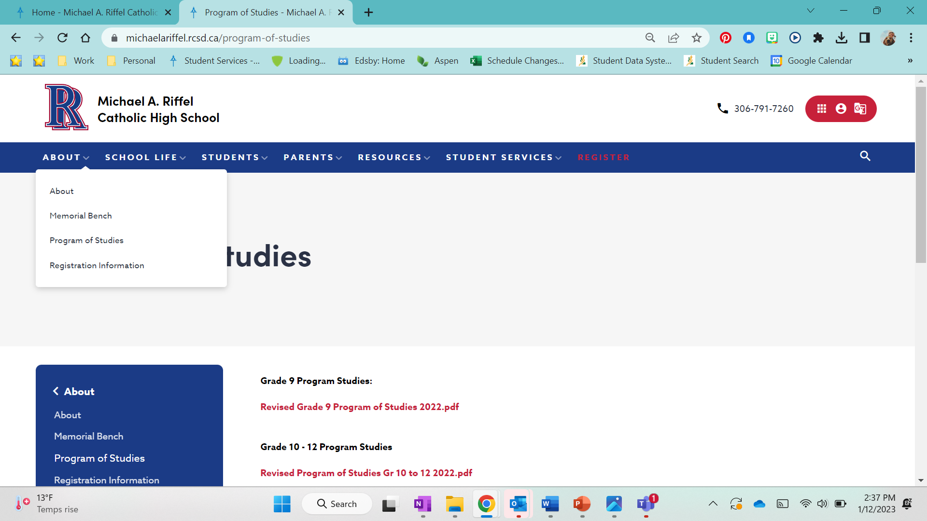
Program of studies
Provides information regarding:
  Graduation requirements
  Detailed course descriptions of all compulsory and elective courses.
  Required course pre-requisites
  Advanced Placement program information

Slide 12
Number of courses required at each grade level
A full schedule of 10 courses is always recommended at each grade level; however, each grade does have a minimum number of courses required.
Grade 10 level – 10 courses are required
Grade 11 – A minimum of 8 courses are required (with a maximum of one study hour per semester)
Grade 12 – Graduation eligibility, post-secondary career paths, and personal interests should guide course selection.

Slide 13

Number of courses required at each grade level
Grade | Choose 10 classes | Can a Study Period be added if needed to support academics?
10 |  | No
11 |  | Yes
12 |  | Yes

Slide 14
helpful information
With the exception of science and math, students may not take compulsory subjects from higher grade levels.
As long as students meet the prerequisite requirements, students can take elective courses from one grade level above.
Advanced/AP courses are challenging. Please talk to your current subject specific teachers for some guidance in choosing these courses.
Ongoing evaluation of potential post-secondary plans is recommended in order to ensure appropriate course selection by grade. This includes research of potential post-secondary programs, conversations with Guidance Counsellors and subject area teachers, and engagement with myBlueprint or other research tools.

Slide 15
Post-secondary requirements
Post – secondary institutions and programs vary in admission requirements.
Spending some time with your child to investigate and research career paths will be helpful. Investigate institutions that offer programs of interest and review specific high school course requirements.

Slide 16
What is your post-secondary plan?
OR
What are your 'maybes'?
What is your plan for post-secondary?
What have you ruled out?
What is in your 'maybe' list?
Planning courses around your 'maybes' is important as you move into Grade 11 and Grade 12.

Slide 17
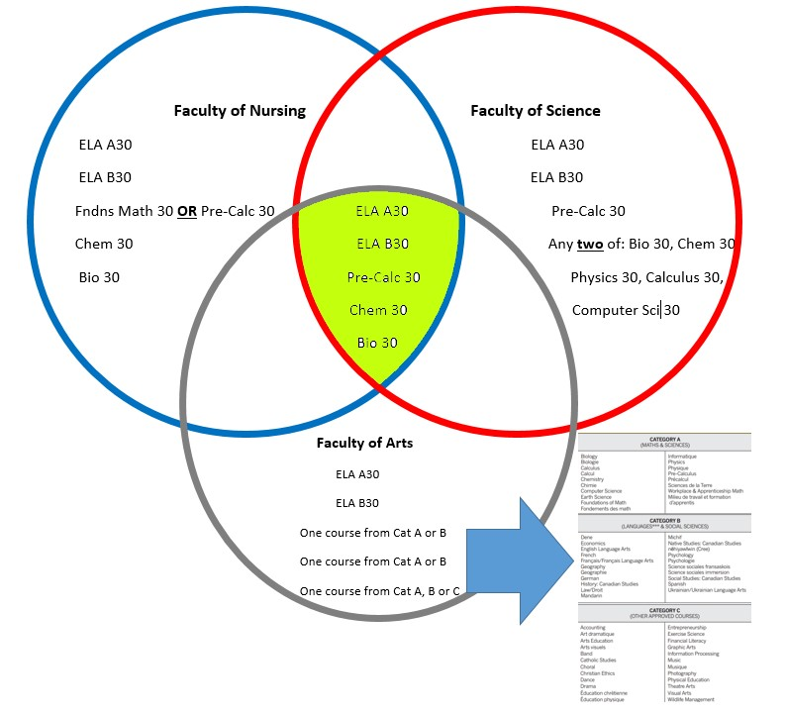
Example of 3 'maybes' figuring out the classes you need to keep your desired options open

Slide 18
Post-secondary applications
Saskatchewan Polytechnic
  Applications for many programs open September 1st of your grade 12 year for the following fall.
University of Regina
  The U of R offers several Early Admission opportunities for a reduced application fee. Otherwise, priority admissions deadline is March 15. We encourage students to apply before the end of January.
University of Saskatchewan
  Application deadlines vary depending on College.
Other Canadian and U.S. institutions
  Application deadlines vary, please begin researching programs of choice.

Slide 19
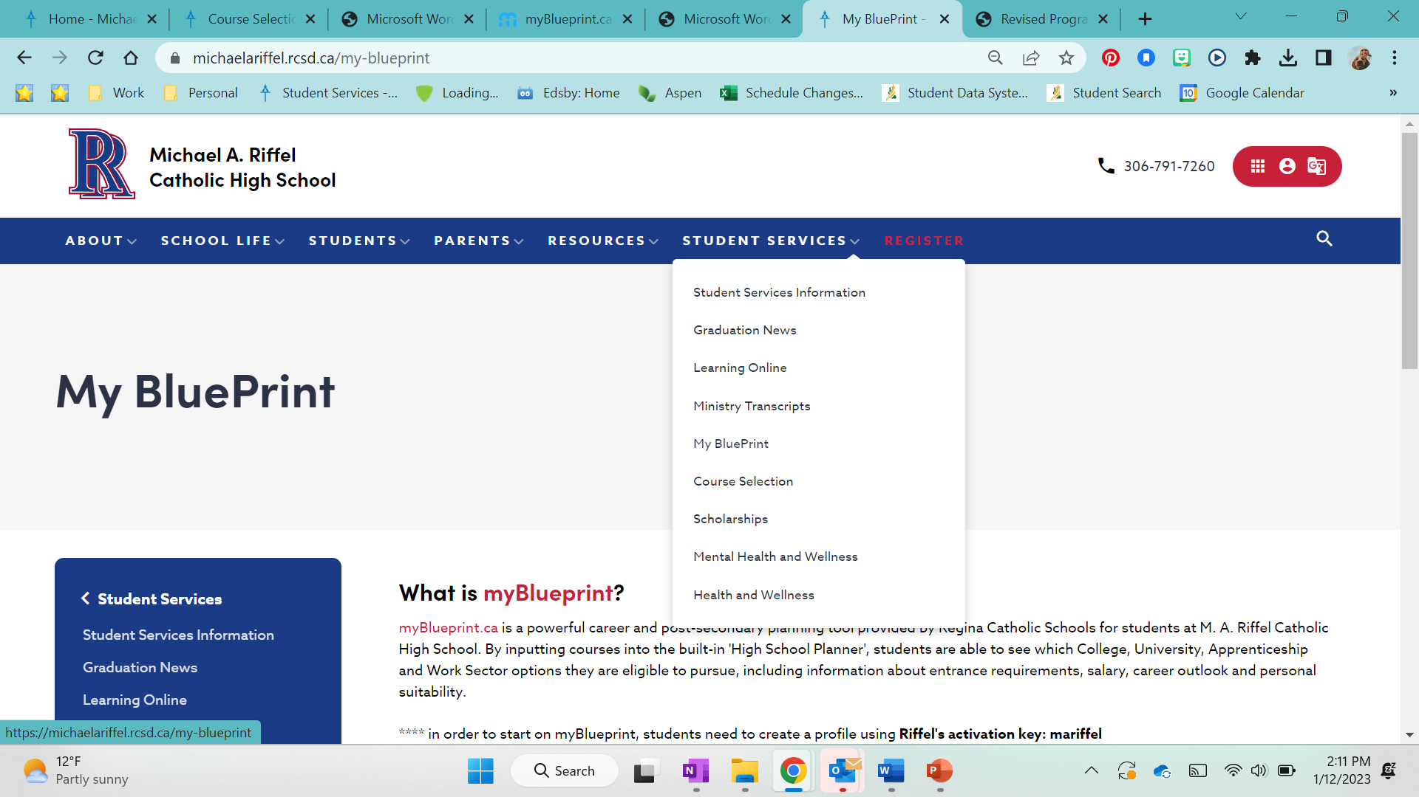
Research tool
MyBlueprint is an excellent resource that follows a comprehensive education and career planning process that meets the learning needs, interests, and aspirations of all students.
If your child does not know their username and/or password, please ask them to reach out to Student Services.

Slide 20
Mathematics
Mathematics offers three different pathways
  Workplace and Apprenticeship Math
  Foundations of Math
  Pre-Calculus
How do we choose the one that's right for us?
  Give strong consideration to your child's post-secondary plans.
  Please encourage your child to discuss math pathways with their current math teacher.

Slide 21
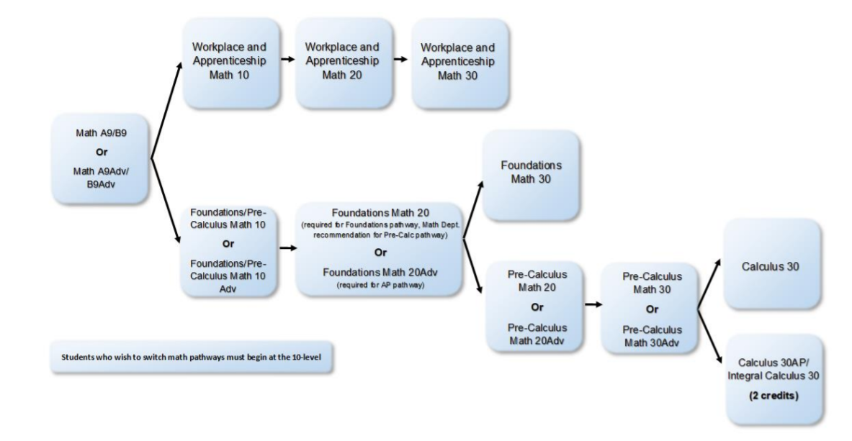
Mathematics pathways
* denotes Pre-AP pathway

Slide 22
Recommendations for math pathways
Current Grade 9 students in selecting Workplace and Apprenticeship (W/A) Math 10 and/or Foundations/Pre-Calculus Math 10:
  If your mark in Math 9 is lower than 60%, W/A Math is recommended.
  If you plan to take Calculus later, you should take Foundations/PreCalc 10 in semester 1, and Foundations 20 in semester 2 of your grade 10 year.
  You can always choose both at the grade 10 level and commit to a pathway in your grade 11 year.
  It is not recommended to take Pre-Calculus 20 in grade 10.
  If you are unsure of which pathway to choose, your child should consult their current math teacher.

Slide 23
science
Riffel offers a variety of natural sciences. They each provide a unique experience and have required prerequisite course requirements.

Slide 24
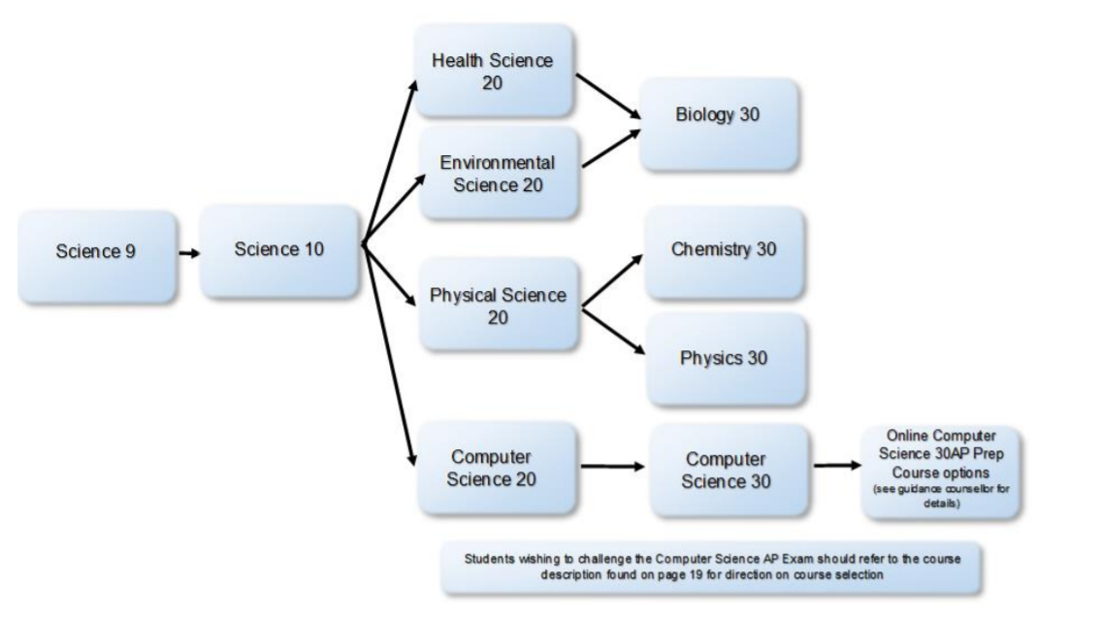
Science pathways

Slide 25
Suggested science pathway to obtain all 30-level natural science courses
 | Semester 1 | Semester 2
Grade 10 | Science 10 | Environmental Science 20 or Health Science 20
Grade 11 | Biology 30 | Physical Science 20
Grade 12 | Chemistry 30 | Physics 30

Slide 26
Additional opportunities
Opportunities for Enrichment
  Pre-AP/AP Programming
  High Performance Phys Ed
  UR Accelerated
  Magnet Courses
  TASCAP
Opportunity for Flexibility
  Learning Online

Slide 27
Advanced placement (AP) programming
Riffel offers Advanced Placement (AP) at the grade 12 level for the following courses:
  AP Calculus 30
  AP English Language Arts A30/B30
  AP Psychology 20/30 (can take in grade 11)
  AP Studio Art 30/Visual Art 30
  AP Computer Science (available via RCSD Learning Online)
Each AP experience is completed over two semesters and grants two high school credits.
A three-hour university level exam is written in May. Students may also achieve a 100-level university credit dependent upon the mark achieved in this exam and the post-secondary institution the student chooses,
AP courses are rigorous and hold opportunities for supplemental reading, assignments and enriched content.

Slide 28
Ap calculus
 | Semester 1 | Semester 2
Grade 10 | Math Foundations and Pre-Calc 10AD | Math Foundations 20AD
Grade 11 | Pre-Calculus 20AD | Pre-Calculus 30AD
Grade 12 | Calculus 30AP | Calculus 30AP (Exam in May)

Slide 29
AP English pathway
 | Semester 1 | Semester 2
Grade 10 | ELA A10 AD | ELA B10 AD
Grade 11 | Creative Writing 20 | ELA 20 AD
Grade 12 | ELA A30 AP | ELA B30 AP (Exam in May)

Slide 30
AP psychology pathway
 | Semester 1 | Semester 2
Grade 11 or 12 | Psychology 20 AD | Psychology 30 AD (Exam in May)

Slide 31
AP computer science pathway
 | Semester 1 | Semester 2
Grade 11 | Computer Science 20 (semester 1 or 2)
Grade 12 | Computer Science 30 | Robotics and Automation 30 AP Prep (Exam in May)

Slide 32
AP studio art pathway
 | Semester 1 | Semester 2
Grade 11 | Visual Art 20 | Studio Art 20L
Grade 12 | Visual Art 30 AP | Studio Art 30L (Portfolios submitted May)

Slide 33
High performance phys. Ed.
This course presents a unique opportunity for students who are ready to compete and excel at the highest level of competition possible.
Students will be given the opportunity to train during the school day.
Students work on strength and conditioning targeted to improve their skills, performance and fitness level.
Students engage in athlete-centered learning outcomes and leadership opportunities.
Students commit to high-volume and high-intensity training throughout the school year that focuses on mind-body connection.

Slide 34
Ur accelerated courses
The U of R High School Accelerated program provides students with the opportunity to receive both a high school credit and a university credit for each course that is successfully completed.
Course offerings vary. Typical course offerings include:
  English 100
  Anthropology 100
  Art 220
  Business 100
  Indigenous Studies 100
Standard tuition and registration fees apply.
Students interested in this option should see Student Services.

Slide 35
magnet courses
Students can take magnet courses within Regina Catholic Schools.
Miller High School
Commercial Cooking 10/20/30
Construction 10/20/30
Cosmetology 10/20/30
Mechanics 10/20/A30/B30
Welding 10/20/30
Advanced Baking 30
**Students may be scheduled for a half day, and are responsible for their own transportation
Michael A. Riffel High School
Energy & Mining 20/30
Emergency Services 20/30
Please contact Student Services if this is a program of interest.

Slide 36
Trades and Skills Construction apprenticeship program (TASCAP)
The Trades and Skills Construction Apprenticeship Program (TASCAP) gives grades 11 and 12 students the opportunity to spend a semester on the Habitat for Humanity Regina build site.
Students learn new skills and give back to their community by building homes for local families,
Participants commit to one full-time semester on build site.
Students earn 500 apprenticeship hours and 5 high school credits.

Slide 37
Learning online opportunities
(Offerings subject to change)
Grade 10 | Grade 11 | Grade 12
ELA A 10 | ELA 20 | ELA A30
ELA B 10 | W/A Math 20 | ELA B30
W/A Math 10 | Foundations Math 20 | W/A Math 30
F/P Math 10 | Pre-Calc Math 20 | Foundations Math 30
Science 10 | Env. Sci. 20 | Pre-Calc Math 30
History 10 | Health Sci. 20 | Chemistry 30
French 10 | Comp. Sci. 20 | Physics 30
Comm. Media 10 | Physical Sci. 20 | Computer Science 30
Robotics/Auto. 10 | Psychology 20 | Native Studies 30
Accounting 10 | History 20 | Law 30
 | Accounting 20 | French 30
 | Comm. Media 20 | Comm. Media 30
 | French 20 | Life Transitions 30
 | Creative Writing 20 | Robotics/Auto. 30

Slide 38
Registration process
Online registration through MSS (My School Sask) takes place from:
March 1st, 2023 – March 8th, 2023
Detailed instructions have been sent via email and can be found on Riffel website.
Once courses have been selected, print off course verification for your records

Slide 39
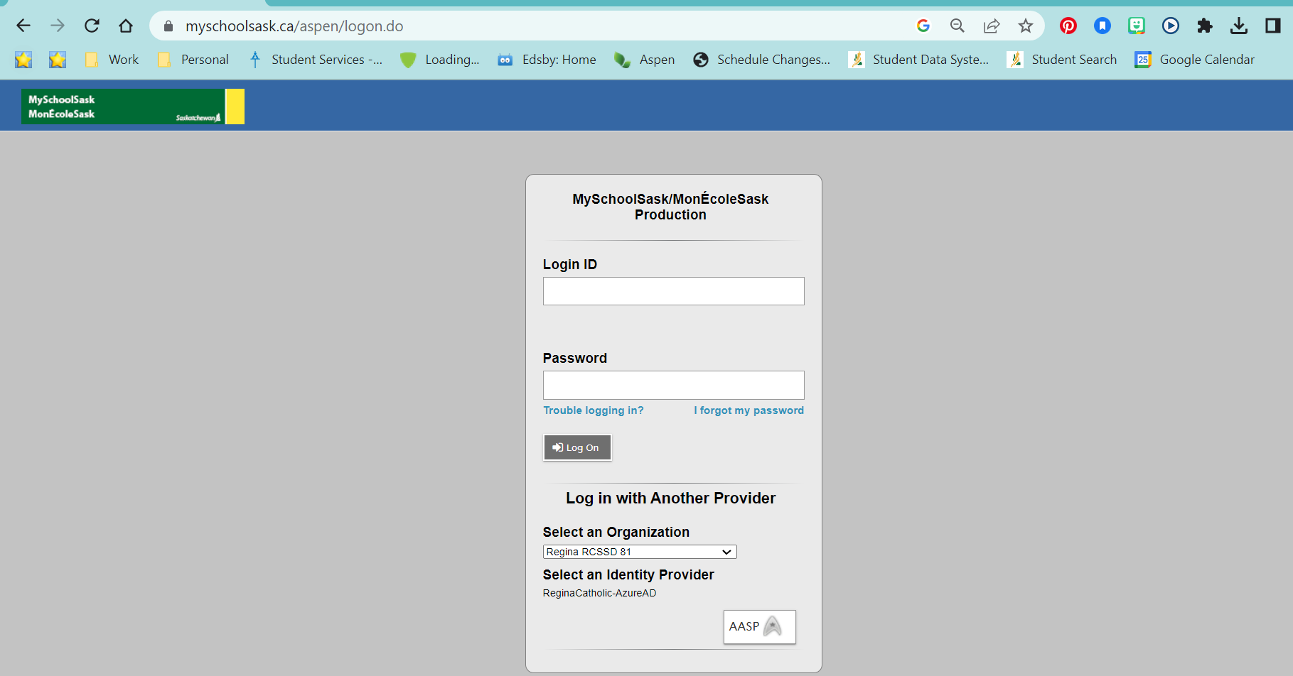
Step 1 – Log onto MySchoolSask

Slide 40
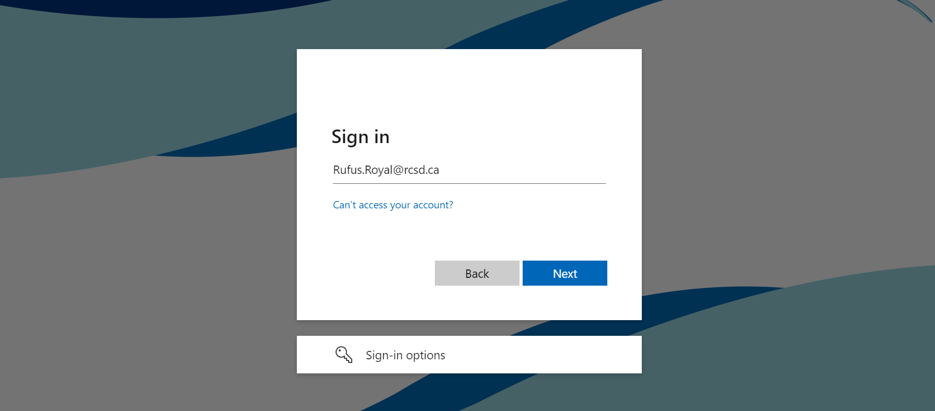
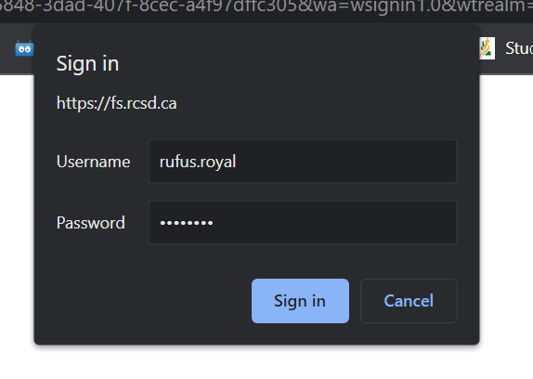
Step 2 and 3 – Enter Log in Information (Student Office 365 username and password)

Slide 41
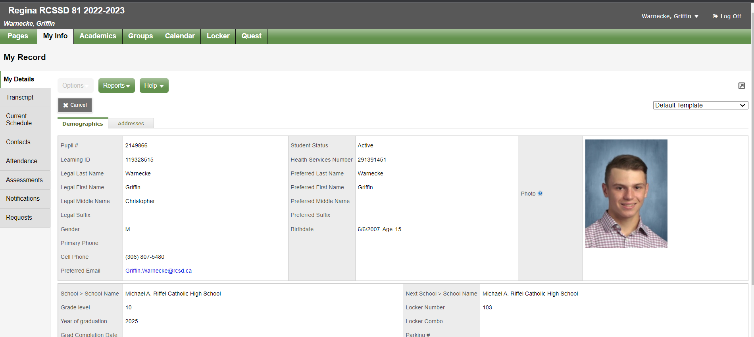
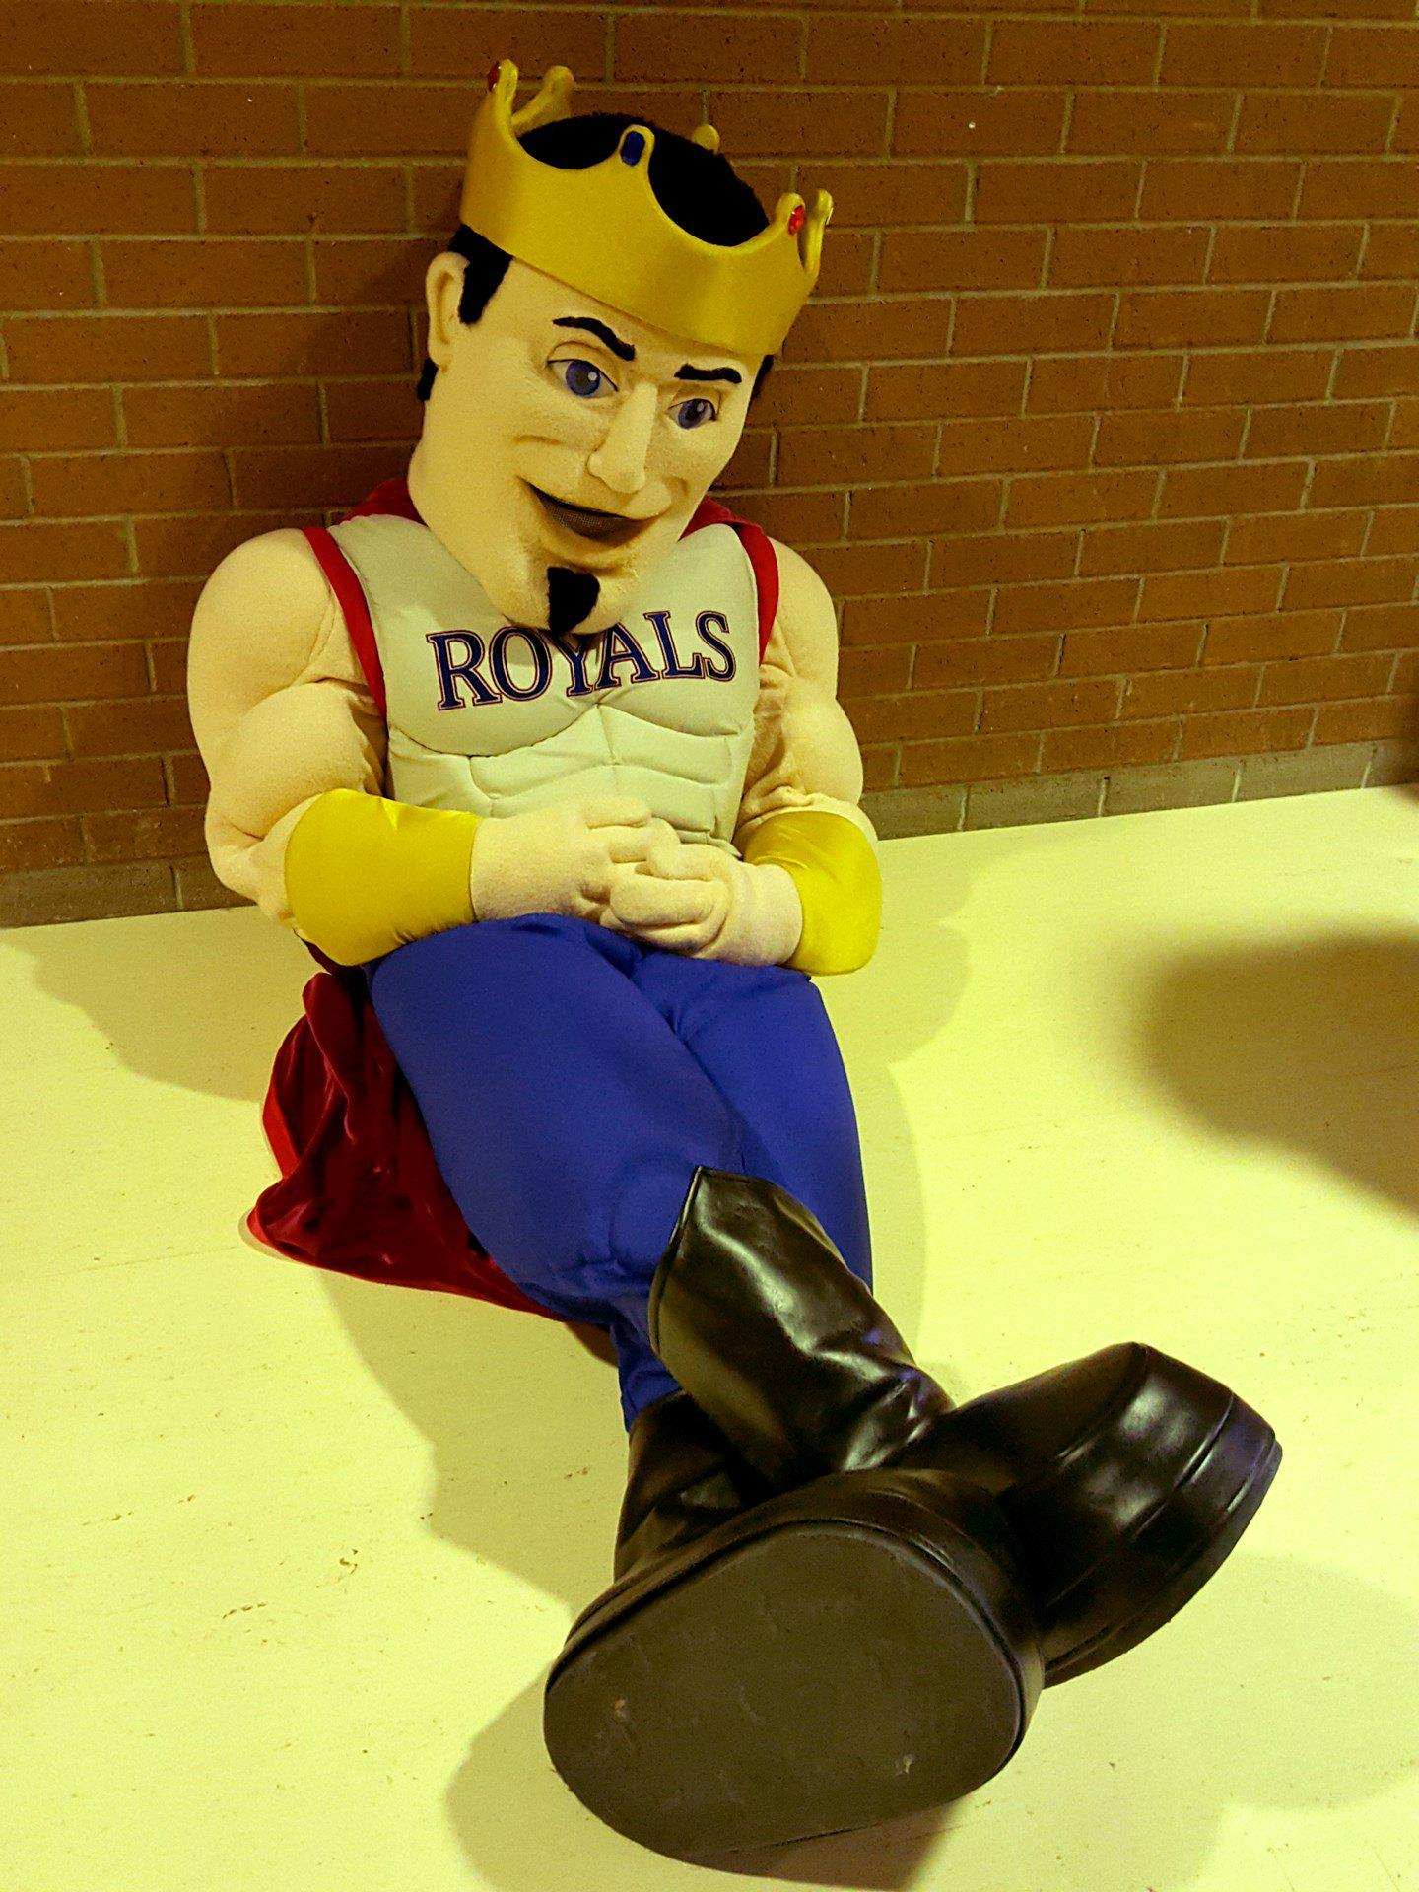
Step 4 – Click the “My Info Tab”- top left

Slide 42
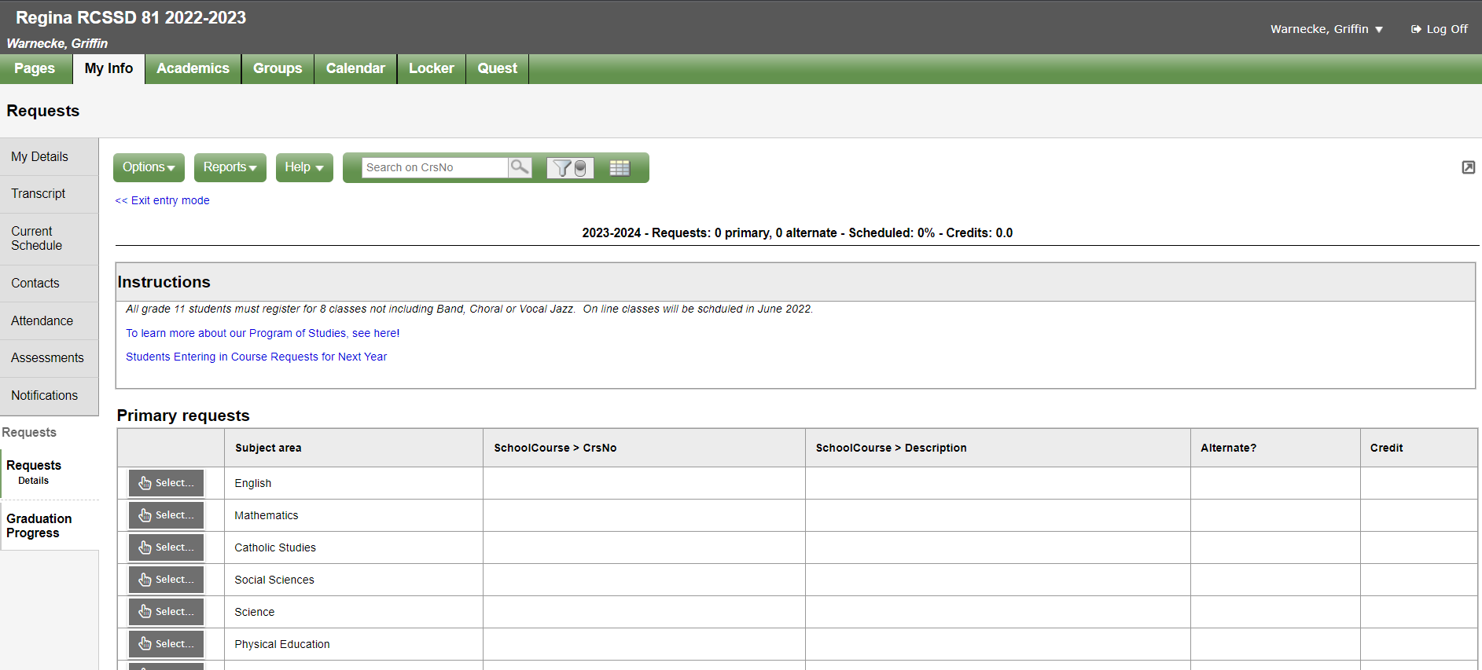
Step 5 – Click the “Requests”- Side left

Slide 43
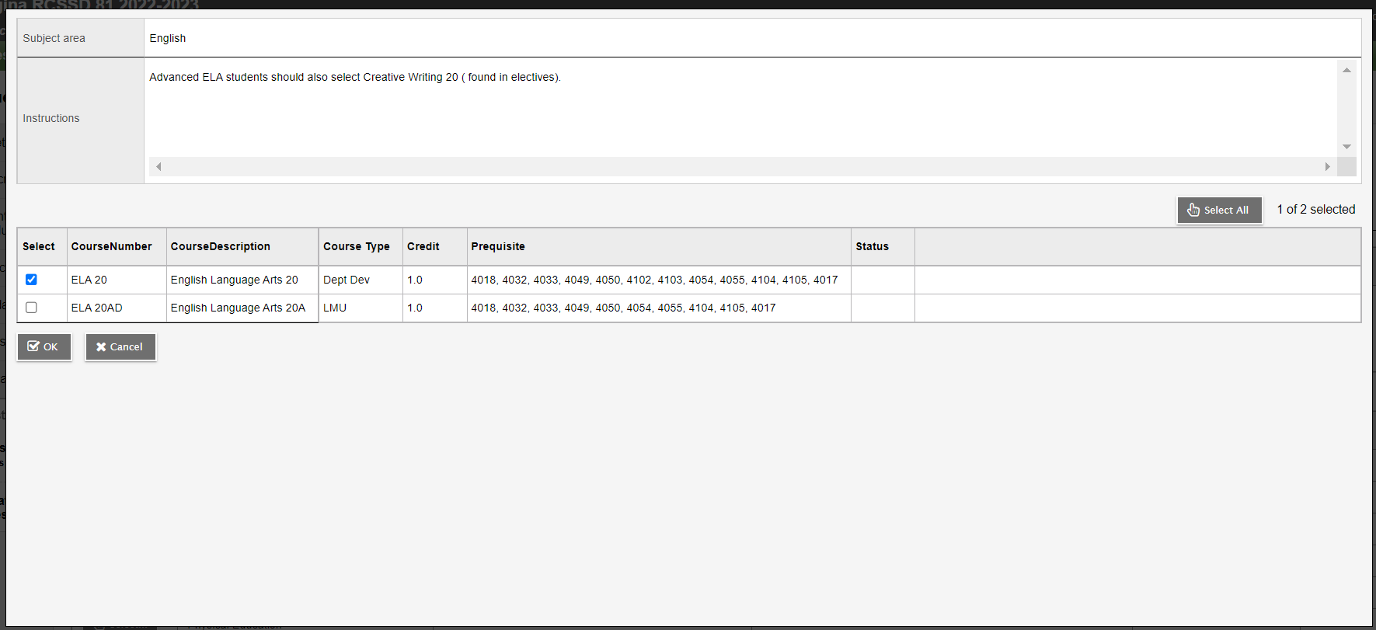
Step 6 – Click “Select” for each of the Subject Areas and make selections

Slide 44
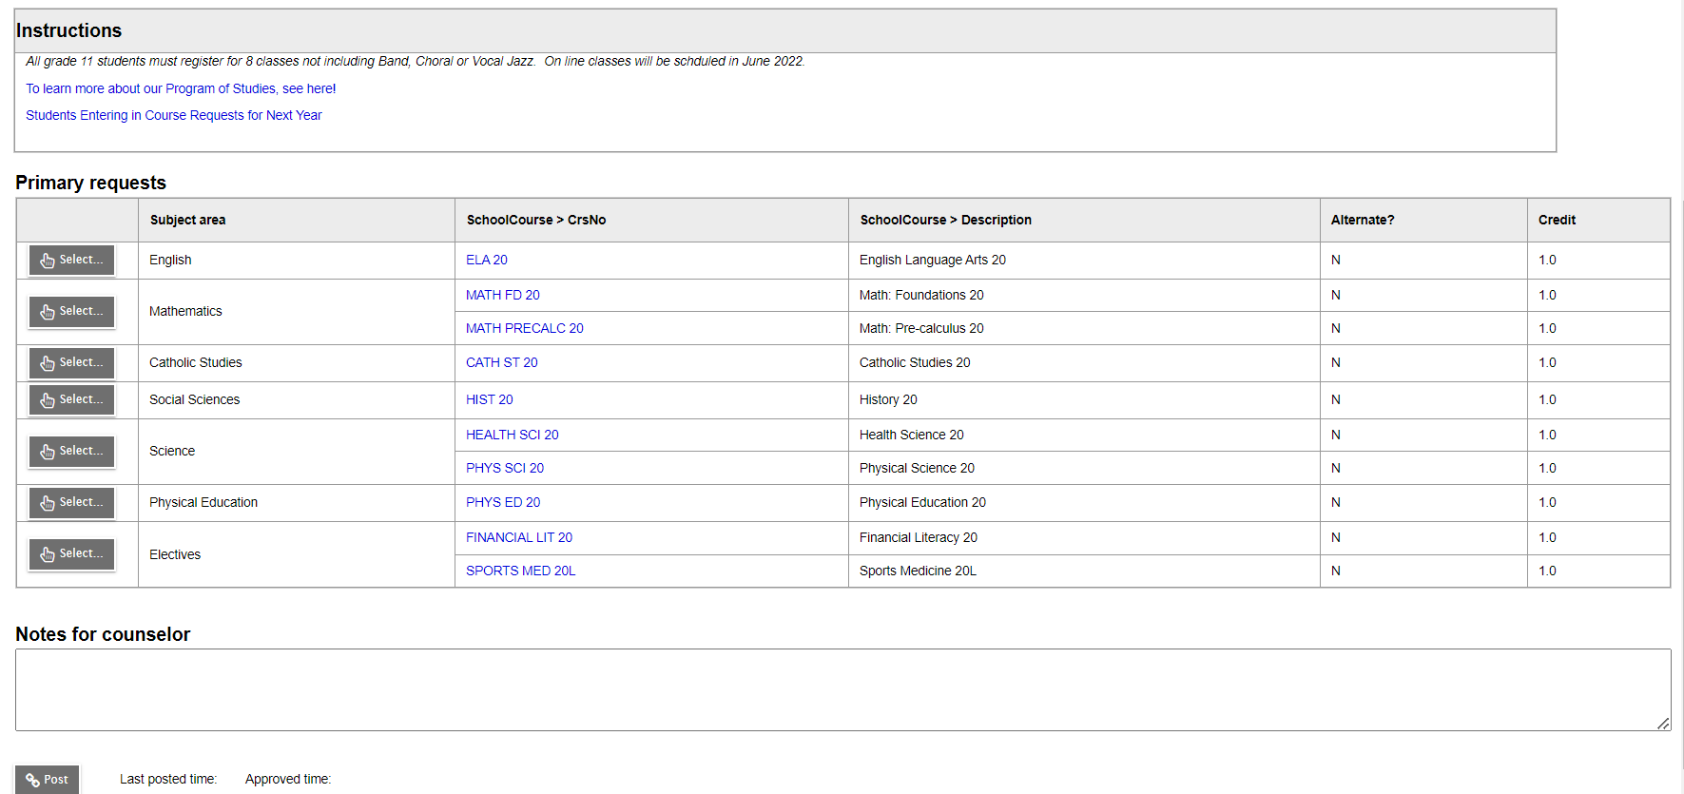
Step 7 – Review Selections

Slide 45
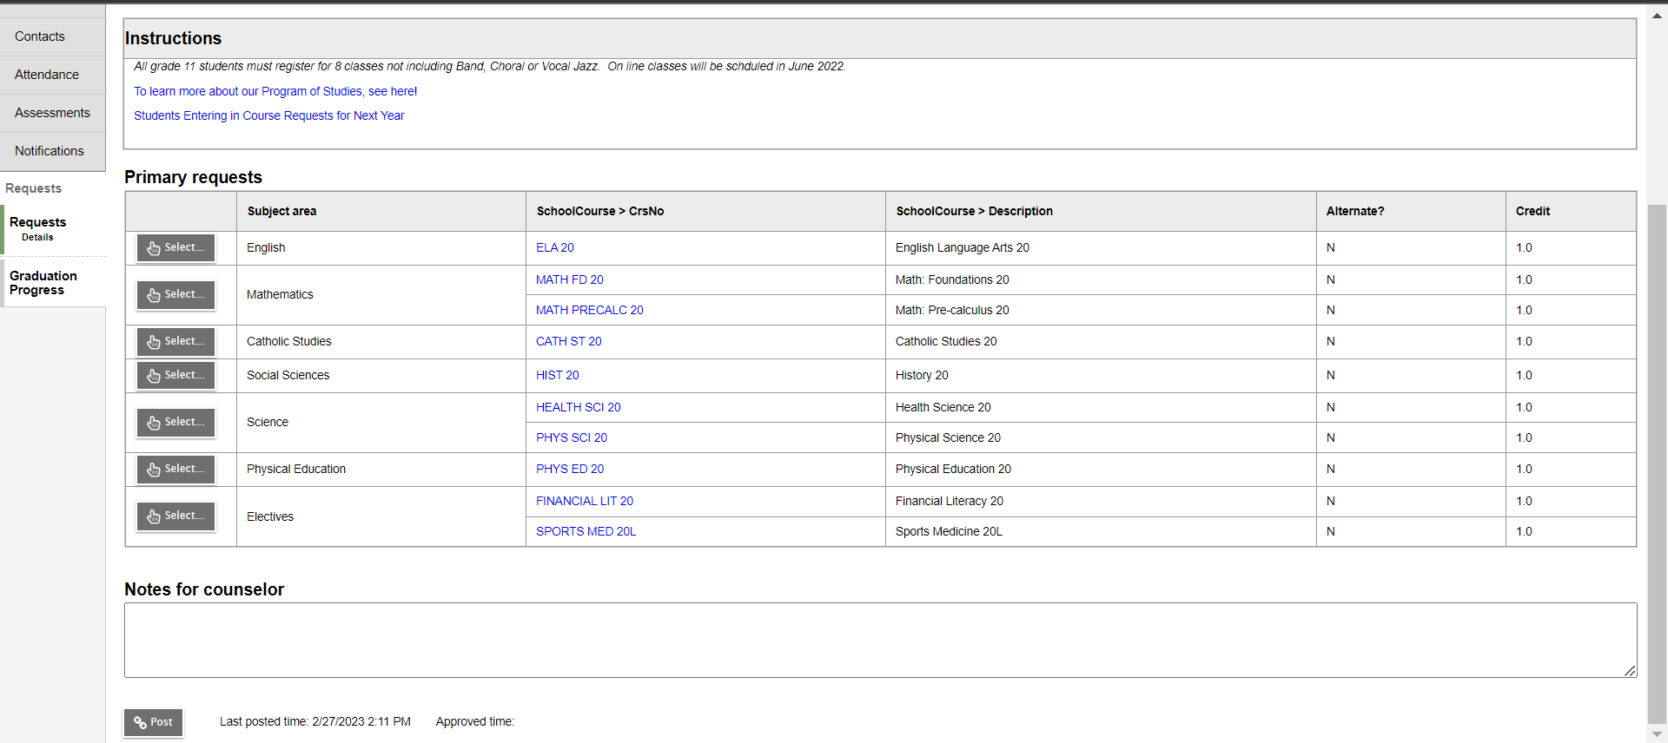
Step 8 – “Post” and save a copy for yourself

Slide 46
Questions?
Contact riffelguidance@rcsd.ca

