Slide 1

Michael A. Riffel Catholic High School parent Graduation Meeting
Welcome, Grade 12 students and families!

Slide 2
Land acknowledgement
In the name of the Father, the Son, and the Holy Spirit. Amen. Loving Creator, please watch over our students and their families as they prepare for graduation.
Bless our students with Your gifts of wisdom and knowledge and the courage to aspire to greatness, as is Your intention for all of us.
In Jesus’s name we pray.
In the name of the Father, the Son, and the Holy Spirit. Amen.
prayer
We are blessed to guide and support students on their journey toward graduation on Treaty 4 territory, traditional lands of the nêhiyawak /ᓀᐦᐃᔭᐊᐧᐠ, nakawē / ᓇᐦᑲᐌ /, and Nakota nations, and homeland of the Métis, Lakota, and Dakota nations.

Slide 3

INTRODUCTIONS​
Greetings & Prayer: Mr. Mark Wernikowski, Principal of Michael A. Riffel Catholic High School​
Welcome: Mrs. Lisa Hanson, Guidance Counsellor & Graduation Chair​
Ms. Dawn Norton, Out-going Prom 2022 Chair​

Slide 4
Graduation eligibility
Participation in the Graduation Mass and Exercises is dependent upon:
  24 credit units, including Catholic Studies 30
  The compulsory requirements outlined by the Ministry of Education
  A determination of a student’s eligibility will be made after June 2, 2023 and will be dependent upon a student having a passing grade in all required courses

Slide 5

Board-sanctioned:
Mass & exercises
Non-board-sanctioned: prom
(parent-run)
Michael A. Riffel Catholic High School is pleased to be formally involved with the Graduation Mass and Exercises. These two events are school Board sanctioned activities that all Regina Catholic High Schools are required to organize, plan and supervise on behalf of graduating students and families. As such, it is very important that all students and families observe the regulations concerning appropriate dress, drugs/alcohol and respectful behavior as outlined in RCS School Board policies and our School Student Handbook.
For Grad 22/23, tickets will not be assigned, nor maximum number of seats per family.
A Grade 12 Prom has traditionally been organized by a parent committee near the end of May. In regards to this event and any other events/activities organized around and outside of the graduation mass and exercises, please keep in mind that they are not School Board sanctioned graduation events and therefore are not a part of Regina Catholic Schools’ supervision and liability.
2022 Prom Chair – Introduction & Transition to 2023 Prom Chair

Slide 6
September to may timeline
September – February:
Payment of Grad fees (deadline February 1, 2023)
February:
Register online for Grad photos (link in booklet)
March:
Cap and Gown Pictures - March 13-16, 2023 (Riffel Commons Area from 9:00 am to 3:00 pm)
You must have your picture taken for the yearbook and composite even if you are not purchasing a package.
Retake Date – At the studio. Call (306) 949-8448 for a retake appointment.
Please review Grad Booklet for additional details.
April:
Graduation Awards applications open
May:
Voting on Valedictorian/Salutatorian
Notify Lisa Hanson, Grad Chair, for wheelchair seating needs.

Slide 7
June timeline
June:
Friday, June 2, 2023 – Grad eligibility determined.
Monday, June 19, 2023 – Period 3 – Grad Rehearsal Attendance is mandatory. This rehearsal is absolutely essential and its importance cannot be overemphasized.
Monday, June 26, 2023 – Graduation Gown, Cap and V-stole pick-up between 11:00 am – 12:30 pm in the Riffel Commons Area.
Wednesday, June 28, 2023 – Graduation Mass at Holy Family Parish at 7:00 pm
Thursday, June 29, 2023 – Graduation Exercises at Conexus Arts Centre at 9:30 am.
Please check the Graduation page on our school website regularly to stay up to date.

Slide 8
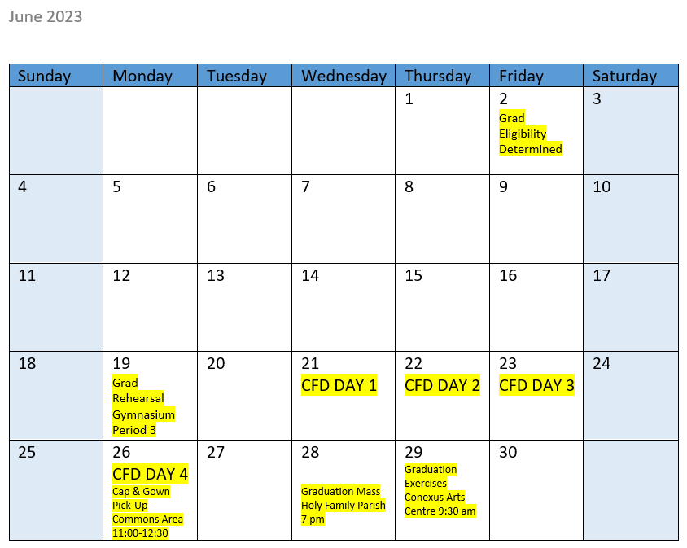

June calendar

Slide 9
Graduation fees
Graduation fee of $100.00 includes:
Cap, v-stole and gown (grads keep these, they are not returned), church and Conexus Arts Centre rental, printing of programs, printing of certificates, Art Legacy and miscellaneous liturgical and guest-related items.
Graduation Fee deadline is Wednesday, February 1, 2023.
All grad fees are to be paid via SchoolCash online program. The link is located at the bottom of the school website.

Slide 10
Graduation MASS
Graduands will proceed into the church at the start of Mass and will sit together in a designated area (Graduands will rehearse this process at the mandatory graduation rehearsal on Monday, June 19, 2023 during period 3). Graduands will carry the graduation cap under their arm as they process into the church.
Doors to Holy Family Parish will open at 6:30 pm and the Graduation Mass will begin at 7:00 pm. Seats are available on a first-come basis. Certain rows at the front of the church will be reserved for the Graduands.
Please remember that Holy Family Parish does not allow food or drink in the church during Graduation Mass.
Holy Family Parish also does not allow hats to be worn inside the church (an exception is made only for the graduation caps worn by our Graduands).
Holy Family Parish must enforce the provincial and city smoking bylaws which state that smoking/vaping is not allowed inside a public building at any time, and that such activities must be done outdoors a minimum of three metres (15 feet) from any building entrance.
For the benefit and enjoyment of all those in attendance for our Graduation Mass, we are requesting that individuals refrain from leaving the building during any portion of the Mass. This ensures that noise and distractions are at a minimum. The entire program runs approximately 1 ½ hours and this may prove lengthy for small children.
Wednesday, June 28, 2023
7:00 pm
Holy Family Parish
1021 McCarthy Boulevard

Slide 11
Graduation exercises
Doors to Conexus Arts Centre will open at 9:00 am and the Graduation Exercises will begin at 7:00 pm. Seats are available on a first-come basis.
Graduands must proceed backstage at 9:00 am and find their labeled seats on the stage risers. They will remain seated on the stage for the duration of the program.
Please refrain from bringing food or drink to Conexus Arts Centre.
Conexus Arts Centre must enforce the provincial and city smoking bylaws which state that smoking/vaping is not allowed inside a public building at any time, and that such activities must be done outdoors a minimum of three metres (15 feet) from any building entrance.
The entire program runs approximately 1 ½ hours and this may prove lengthy for small children.
Thursday, June 29th, 2023
9:30 am
Conexus Arts Centre
200 Lakeshore Drive

Slide 12
ACADEMIC DRESS REQUIREMENTS
(CAP & GOWN)
The academic dress worn by the Graduand consists of a blue gown, cap and a red v-stole. The cost is included in the graduation fee. These are keeper gowns, so no need to return them!
Gowns, caps and v-stoles MUST be picked up at the school on Monday, June 26, 2023 in the Commons Area between 11:00 am and 12:30 pm.
Dress clothing is required under the gowns. Boys may wear a shirt and tie, dress pants and dress shoes. Girls may wear either a dress, or a top and dress pants and dress shoes. NO shorts, flip-flops, or beach type shoes of any kind may be worn.

Slide 13

VALEDICTORIAN & SALUTATORIAN
VALEDICTORIAN:
Serves as the representative voice of the entire graduating class. This position should be looked upon as an honour.
SALUTATORIAN:
Also an honoured position, has the responsibility of welcoming everyone to the graduation.
Procedure for Selecting the Valedictorian and Salutatorian:
The top four eligible graduands based upon Semester One averages are eligible and have been nominated for Valedictorian and Salutatorian. The nominee receiving the highest number of votes will be the Valedictorian and the nominee receiving the second highest number of votes will be the Salutatorian. These speeches will be determined based on grad eligibility.
Voting on these positions will take place in April/May via emailed Microsoft Form. Please have students listen to announcements for further details.
The Valedictorian and Salutatorian must have their speeches approved by the Graduation Chair and School Administration. School Administration reserves the right to remove any student from these roles if they do not adhere to the recommendations regarding speeches.

Slide 14
Graduation Awards
There are several Graduation Awards offered to Riffel students. Please consider applying along with other scholarship applications!
Go to:
  Riffel Main Page
    Student Services
      Drop down menu
        Graduation News
          Graduation Awards
Please review the following awards and their criteria and consider applying!
Applications (via Microsoft Form) will open in April/May. Please listen to announcements!
  Campion Future Scholar Award ($1000)
  Catholic Leadership Award ($500)
  Circle of Voices - Indigenous Grade 12 Student Award "Inspiring Success" ($500)
  Clarke Johnston Estabrooks & Miller Law Office​ Award ($750)
  Holy Family Knights of Columbus Christian Attitude Award ($100)
  Indigenous Student Achievement Award ($500)
  Michael A. Riffel Family Christian Service Award ($250)

Slide 15
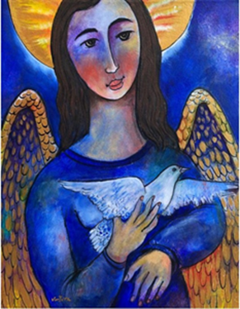
Art Legacy
Graduating students contribute towards the purchase of a piece of art, which is donated to the school as their legacy.
The works of art from previous years are displayed at the school with accompanying plaques indicating title, artist, year and contributor.

Slide 16

Thank you for attending!
Any questions? Please ask! Or…
Email Lisa Hanson, Graduation Chair – l.hanson@rcsd.ca
Email Mark Wernikowski, Principal – m.wernikowski@rcsd.ca
Call Riffel Main Office – 306-791-7260

